Slide 1
Implementasi Struktur Data 2020/2021 Pengantar Struktur Data
Program Studi Diploma III REKAYASA PERANGKAT LUNAK APLIKASI

Slide 2

Remember this?
Algorithm
A clearly specified set of simple instructions to be followed to solve a problem
What is a good algorithm?
The longest?
The biggest?
The scariest?
The most efficient → running time, memory

Slide 3
Data Structure - Definition
When you stopped at the store this morning, you went to the back of a line to wait for the cashier.
Do you see a stack of books or a pile of papers on your desk? It’s easy to look at or remove the top. item of the stack or to add a new item to the top of the stack.
At your desk, you see your to-do list. Each entry in the list has a position that might or might not be important to you.

Slide 4
Data Structure - Definition
Your dictionary is an alphabetical list of words and their definitions.
Speaking of your computer, you have organized your files into folders, or directories. Each folder contains several other folders or files.
Finally, notice the road map that you are using to plan your weekend trip. The diagram of roads and towns shows you how to get from one place to another.

Slide 5
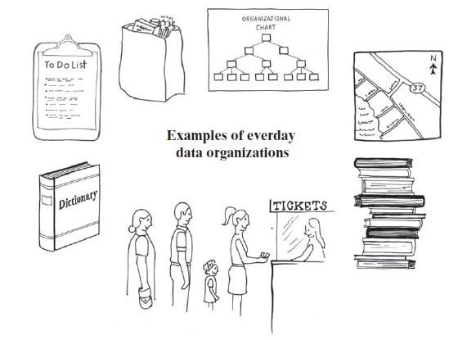
Data Structure - Definition
A data structure is a way of organizing input data and operations which can be performed on this data (e.g. add, delete, find an element).
Notes:
Data structures: to store data in an efficient way
Why to use data structures?
We often have the intuition → if we want to make an algorithm fast, we have to optimize it
Avoid nested for loops
Make every calculation as fast as possible
Algorithms can be boosted up by proper data structures.
Data structures make sure the running time will be better.

Slide 6
So, why data structure?
The data structures govern the space and time consumed by your running program.
In addition, large programs take time to write. Using different structures can actually have an impact on how long it takes to write your program.
Choosing the wrong structures can cause your program to run poorly or be difficult or impossible to implement effectively.
Algorithm + data structure = program
Notes:
Algorithm + data structure = program
Choosing a proper data structure and designing a correct, efficient, and well-structured algorithm are heart of software design.

Slide 7
Example of Data Structure
Array
Linked List
Stack
Queue
Tree
Graph

Slide 8
Abstract Data Type (ADT)
Data Structure Implementation

Slide 9

ADT - Overview
Computer programs also need to organize their data. Programs can use a list, a stack, a dictionary, and so on. These ways of organizing data are represented by abstract data types.
An abstract data type, or ADT, is a specification that describes a data set and the operations on that data.
Each ADT specifies what data is stored and what the operations on the data do. ADTs independently of any programming language it doesn’t indicate how to store / how to implement!
In contrast, a data structure is an implementation of an ADT within a programming language.
A collection is a general term for an ADT that contains a group of objects.
A container is a class that implements a collection. Some people use the terms “container” and “collection” interchangeably.
Notes:
Demikian pula, seringkali tidak penting bagaimana suatu struktur data dibentuk untuk dapat menggunakannya. Misal, kita semua terbiasa menggunakan array, tapi jika dipikirkan lebih dalam, kita akan merasa bingung: apakah semua indeks yang berurutan pada array juga disimpan berurutan di memori, atau tersimpan saling berjauhan?
Jawabannya?
Hal tersebut tidak penting ☺ Selama array yang kita buat bekerja sebagaimana seharusnya, tak ada masalah bagi kita. Kita hanya perlu dapat mengimplementasikannya.
Tanpa sadar, kita telah sering menggunakan abstraksi (abstraction) dari suatu tipe data

Slide 10
ADT - Overview
ADT, is a specification for a group of values and the operations on those values that is defined conceptually and independently of any programming language.
Imagine a paper bag, a reusable cloth bag, or even a plastic bag.
People use bags when they shop, pack a lunch, or eat potato chips. Bags contain things, but you don’t really care if things order exactly!
Notes:
A bag does not order its contents, but sometimes you do want to order things. ADTs can order
their items in a variety of ways.
ADT list, for example, simply numbers its items. A list, then, has a first item, a second item, and so on,
ADTs stack and queue order their items chronologically,
ADT dictionary contains pairs of items,
ADT tree organizes its entries according to some hierarchy

Slide 11
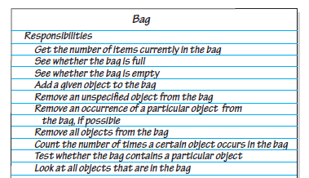
Bag’s Behavior
Bag contains a finite number of objects, reporting how many objects it contains could be one of a bag’s behaviors:
Get the number of items currently in the bag
Two related behaviors detect whether a bag is full or empty:
See whether the bag is full
See whether the bag is empty
We should be able to add and remove objects:
Add a given object to the bag
Remove an unspecified object from the bag
Remove an occurrence of a particular object from the bag, if possible
Remove all objects from the bag

Slide 12
So..?
Abstract data type (ADT) adalah kumpulan objek beserta operasinya. ADT merupakan suatu pemodelan, jadi pada pendifinisiannya tidak dituliskan bagaimana cara implementasi dari operasi ADT.
Ingat perbedaan tipe data (primitive) dengan tipe data objek (reference)?
Tipe data memiliki operasi tersendiri (+, -, * dst), demikian juga ADT memiliki operasi-operasi tersendiri.

Slide 13
Then…
Pembuatan ADT terbagi dua:
Pembuatan interface, yang berisi spesifikasi atau dokumentasi dari ADT.
Implementasi ADT: bagaimana operasi tersebut dilakukan menggunakan struktur data dan perintah yang ada pada bahasa pemrograman tertentu (dalam hal ini, Java)
ADT hanya berisi spesifikasi atau detil dari interface, bukan implementasinya. Pemisahan ini penting, karena user hanya perlu tahu apa saja operasinya, bukan bagaimana cara operasi tersebut dilakukan.

Slide 14
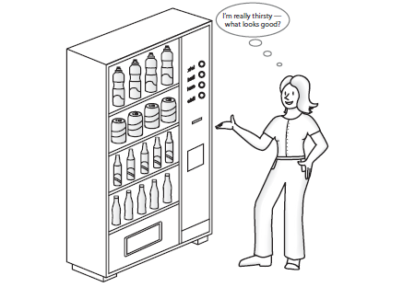
If it’s still confusing…
In general, the steps of building ADT to data structures are:
Understand and clarify the nature of the target information unit.
Identify and determine which data objects and operations to include in the models.
Express this property somewhat formally so that it can be understood and communicate well.
Translate this formal specification into proper language. In Java, this is called "user interface".
Upon finalized specification, write necessary implementation. This includes storage scheme and operational detail. Operational detail is expressed as separate functions (methods).
Using ADT is Like Using Vending Machine!
Notes:
When you look at the front of a vending machine, you see its interface. By inserting coins
and pressing buttons, you are able to make a purchase.
● You can perform only the specific tasks that the machine’s interface presents to you.
● You must understand these tasks—that is, you must know what to do to buy a soda.
You can use the machine even though you do not know what happens inside!

Slide 15
List
Implementasi struktur data

Slide 16
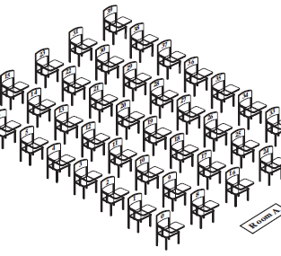

ADT with Array
Array has a fixed size, and so it can either become full or have several unused elements.
Resizing an array -> move data each time to expand an array

Slide 17
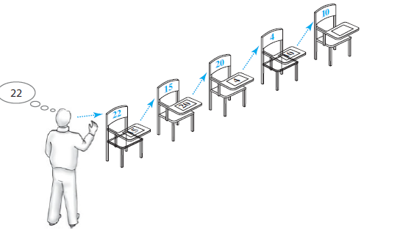
ADT LIST
Data organization that uses memory only as needed for a new entry and returns the unneeded memory to the system after an entry is removed.
By linking data, its avoids moving data when adding or removing entries.

Slide 18
Linked list and array (conventional)
Array | List
Alokasi memory bersifat statis | Alokasi memory bersifat dinamis
Lokasi memory continue (fisik dan logik terurut) | Lokasi pada memori random (fisik dapat terpisah, logik berkaitan)
Operasi pengubahan susunan data relatif memakan waktu | Operasi pengubahan susunan data lebih mudah dan ringkas
Akses data lebih mudah (menggunakan indeks) | Akses data lebih sulit (menggunakan bantuan)

Slide 19
LInkED LIST
Data
next
Data
next
Object In a Bag
Object In a Bag
A linked list is a data structure used for collecting a sequence of objects that allows efficient addition and removal of elements in the middle of the sequence.
A linked list consists of a number of nodes, each of which has a reference to the next node. We call this the next link. The last cell’s next link references null.

Slide 20
Example – ADT Buku
Spesifikasikan terlebih dahulu operasi yang dapat dilakukan pada buku (dengan mengingat karakteristik buku)
Misal, karakteristik buku: Memiliki judul, pengarang, tahun terbit, dan penerbit.
Berdasarkan karakteristik yang ada, tentukan operasi yang bisa dilakukan pada data buku
Memasukkan buku baru
Menghapus buku
Menghitung banyaknya data buku
Mencari buku tertentu

Slide 21
Example – ADT Buku (Cont’l)
Sebelum implementasi, tentukan method berdasarkan spesifikasi yang ada
Beri nama method tersebut, parameter masukannya, tipe data kembalian, dan komentar jika diperlukan
Bisa menggunakan notasi UML untuk memudahkan
Ketika mengimplementasikan dalam program kelak, spesifikasi bagi ADT dapat dipisahkan pada interface.

Slide 22
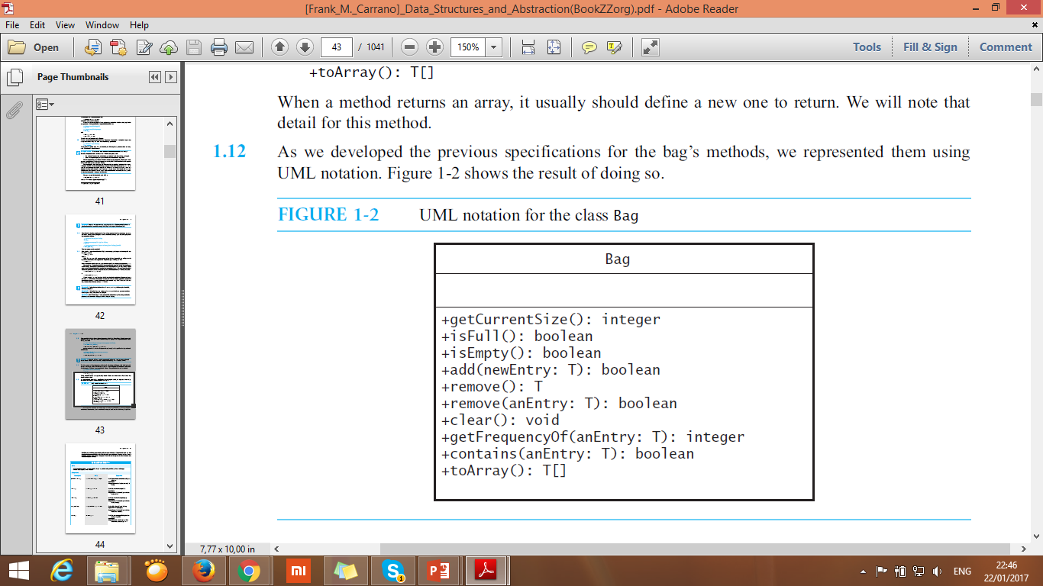
Masih ingat?
Bagaimana dengan ADT Buku yang sudah kita buat sebelumnya?
Source: Carrano, 2001

Slide 23
Specification of ADT List
Penambahan data (biasanya dilakukan pada akhir list, tapi pada dasarnya dapat dilakukan di awal, di akhir dan di tengah-tengah)
Menghapus semua data bku
Mengganti suatu data
Melihat data tertentu
Melihat isi keseluruhan data
Mencari data tertentu pada list
Mencari tahu apakah list kosong atau tidak

Slide 24
Linked List (Cont’l)
Single Linked List
Double Linked List
Circular Linked List

Slide 25
Singly Linked List
Bentuk linked list yang paling sederhana
Objek linked list (head/ first ) memiliki reference ke node pertama dari linked list
Merupakan list satu arah: setiap node memiliki reference ke node selanjutnya pada linked list
Tail
Head
A
next
B
next
C
next

Slide 26
Operasi pada Singly Linked List
Insert (Sisip) :
Sisip Depan (Insert First)
Sisip Belakang (Insert Last)
Sisip Tengah (Insert At Specific Position)
Delete (Hapus):
Hapus Depan (Delete First)
Hapus Belakang (Delete Last)
Hapus Tengah (Delete At Specific Position)

Slide 27
Sisip Depan
Head
C
next
Head = Tail = Null
Pastikan agar Head selalu berada di awal linked list, dan Tail di akhirnya
Tail
Node dengan isi “C” akan dimasukkan pada linked list
Data (isi) node
Reference ke node lain
Keadaan 1:
Linked List masih kosong, dilakukan sisip Depan
C
next
nN
Head
C
next
Head = Tail = nN
Tail

Slide 28
Keadaan 2:
Sisip depan pada linked list yang memiliki isi
Pastikan agar Head selalu berada di awal linked list, dan Tail di akhirnya
Head
C
next
B
next
Tail
nN
Tail
Head
Tail
Head
C
next
B
next
C
next
B
next
nN
Head = nN
nN.next = Head
nN

Slide 29
Sisip Tengah
Tail
Head
B
next
C
next
E
next
Iterator
D
next
Iterator = Head
nN
Sisipkan D antara C dan E
Posisi yang tepat??
Bagian next (iterator) adalah node E

Slide 30
Sisip Tengah
Tail
Head
B
next
C
next
E
next
Iterator
Iterator
while (iterator.next != “E”)
iterator = iterator.next
D
next
nN

Slide 31
Sisip Tengah
Tail
Head
B
next
C
next
E
next
Iterator
Iterator.next = nN
D
next
nN.Next = iterator.next
“Sambungkan” node “D” dengan linked list
nN

Slide 32
Sisip Tengah
Tail
Head
B
next
C
next
D
next
E
next

Slide 33
Hapus Belakang
Pastikan agar Head selalu berada di awal linked list, dan Tail di akhirnya
Pindahkan Tail dari node paling belakang
Gunakan iterator untuk “memegang” node sebelum Tail
Head
Tail
A
next
B
next
D
next
Iterator
Iterator
while (iterator.next != Tail)
iterator = iterator.next

Slide 34
Hapus Belakang
Pastikan agar Head selalu berada di awal linked list, dan Tail di akhirnya
Pindahkan Tail dari node paling belakang
Gunakan iterator untuk “memegang” node sebelum Tail
Head
Tail
Tail = iterator
Tail.next = null
A
next
B
next
D
next
Iterator

Slide 35
DOUBLY LINKED LIST

Slide 36
Sisip depan
Keadaan 1:
Linked List masih kosong, dilakukan sisip Depan
Linked List masih kosong, head dan tail menunjuk ke NULL
Head
Tail
Head = Tail = Null
Head
Tail
Ketika disisipkan node baru, maka head dan tail akan menunjuk node tersebut.
prev
C
next
nN
Head = Tail = nN

Slide 37
Sisip depan
Keadaan 2:
Sisip depan pada saat linked list memiliki isi
Head
Tail
prev
C
next
nN.next = Head
Head.prev = nN
Pastikan agar Head selalu berada di awal linked list, dan Tail di akhirnya
prev
B
next
Head = nN
Head
Tail
nN
Prev
B
next
prev
C
next

Slide 38
Hapus depan
Head
Tail
1. Buat sebuah temporary yang menunjuk pada head
A
next
B
next
C
next
2. Pindahkan head ke node kedua
Head
Tail
Head = Head.next
A
next
B
next
C
next
3. Buat bagian head previous menjadi NULL,
Temporary next menjadi null
Tail
Head
B
next
C
next
Head.prev = null
Pastikan agar Head selalu berada di awal linked list, dan Tail di akhirnya

Slide 39
Reference
Carrano, Frank., Data Structure and Abstraction, Prentice Hall
Weiss ,M. A., Data Structures and Algorithm Analysis in Java 3rd Ed, Pearson Education Inc.
Adams, B. G., Introduction To Computer Science: An Object-oriented Approach Using Java 5, BlueJ and BeanShell Edition.

